Slide 1
Words Whispered in Water: Why the Levees Broke in Hurricane Katrina
JANUARY 21, 2021
Sandy Rosenthal, author Words whispered in water (mango publishing, 2020)
SIR Branch 62 Sunnyvale
Notes:
Cover slide

Slide 2
In New Orleans, the levees are designed and built by the US Army Corps of Engineers.
Notes:
Photo: Mike Collins

Slide 3
After levee breach disaster in 2005, the Army Corps of Engineers blamed anything except itself.
Notes:
Photo: Mike Collins

Slide 4
1500+ deaths. $170B adjusted. Corps refused to answer questions until the studies were complete in June of 2006. ––9 months!

Slide 5
But in the weeks after the disaster
The world watched on TV.
The world wanted to know why asap.

Slide 6
During this critical time in history, the American people – and Congress – heard three reasons for the catastrophic flooding.

Slide 7
Monster storm

Slide 8
City below the sea

Slide 9
Local corruption

Slide 10
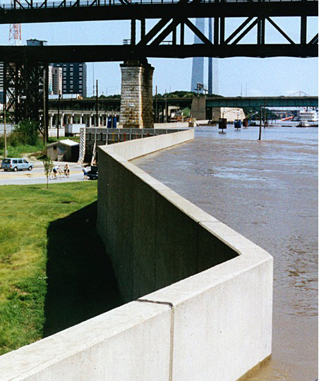
It was all so believable.

Slide 11
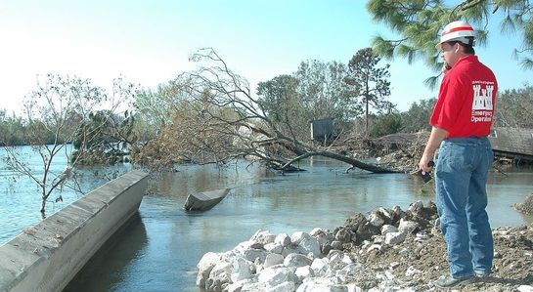
Levees that broke were drainage canals to hold a few FEET of water for a few HOURS once in a while.

Slide 12
Breakthrough! Government Accountability Office (GAO) report published Sept 28, 2005

Slide 13
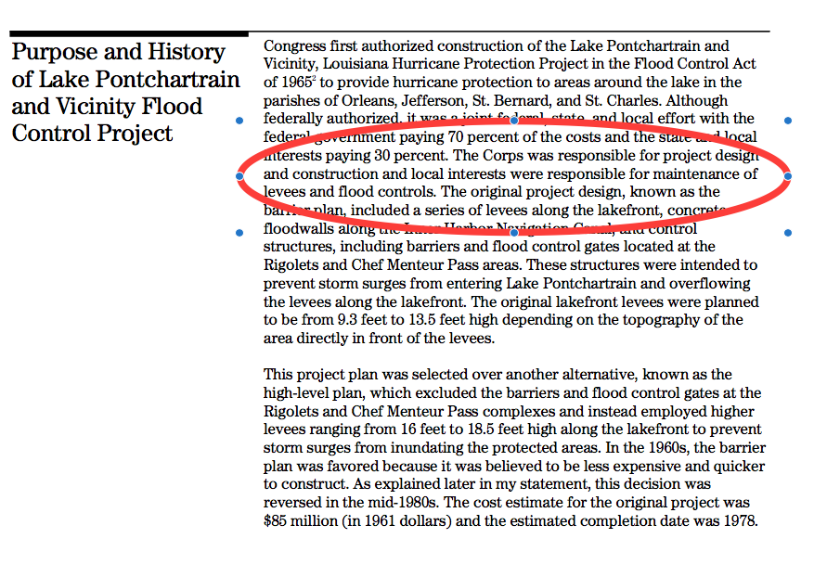

Slide 14
The worst levee breaches were the newest – 17th Street and London Ave Canals. Both completed in 2000.
Notes:
Breach site at 17th Street Canal. The rebuilt monolith sections are clearly wider. Photo/ Roy Arrigo

Slide 15
So I founded the group Levees.org. And started asking questions.
Notes:
Photo/ Stanford Rosenthal

Slide 16
I received immediate push- back from:
U.S. Army Corps of Engineers
Federal agency under Dept of Defense
American Society of Civil Engineer
Large elite trade group

Slide 17
This reinforced my theory that the Army Corps was to blame. And had allied itself with the engineering establishment to rewrite history and protect its reputation. And there was a lawsuit forming…

Slide 18
Levee Spin101
2 years after breaches.
Spoof.
Cozy relationship between the Army Corps of Engineers and the ASCE.
Notes:
Photo/ Francis James

Slide 19
The ASCE did not enjoy this criticism.

Slide 20
Adams and Reese and the Silicon Valley firm Cooley, offered pro bono counsel. We dared the ASCE to sue us. The society withdrew its threat…
Notes:
Photos from http://junctionhill.k12.mo.us/denisknight/Severe%20Weather/Katrina%20Pictures.html

Slide 21
Levees.org announced the news in very well attended press event.
Notes:
Photo/ Pat Garin

Slide 22
Next three years: ~Historic plaques. ~Pushed for federal reform of the Army Corps. ~Caught corps employees at corps HQ using its computers to harass my group online (very embarrassing to the agency).
Notes:
Photo by Gary Michael Smith

Slide 23
In 2011, on the suggestion of an advisor
Levees.org nominated two levee breach sites to the prestigious National Register of Historic Places.
This makes sense.
The historic breach event changed America as we know it.

Slide 24
This is important because the majority (62%) of American population lives by levees.
Notes:
Map created using data Levees.org received in a response to an 2019 request to FEMA under the Freedom of Information Act (FOIA) that was received in July 2020.

Slide 25
The big picture became clearer
I was forced to read the reports of 2008 and 2009.
I discovered important information buried deep in those reports.
Important information that was excluded from executive summaries.
The big picture came together.

Slide 26
The Army Corps of Engineers was singularly at fault.
Not the storm.
Not the geography of the city.
Not any corruption on the part of local people.
Notes:
Bumper sticker

Slide 27
But in 2011, the fairy-tale was household knowledge.
Notes:
Elsa from Disney’s Frozen

Slide 28
And by 2011, I had many detractors…
Paid trolls moderating forums at NOLA.com.
Bloggers with ASCE.
Pulitzer-prize winning journalists who reported wrong information in 2005
Published authors of books in 2006.
Published academics.
Notes:
Sandy Rosenthal’s dog Twinkie in appropriate clothing.

Slide 29
They all quoted a 2006 levee report by University of California Berkeley. To be fair, that report:
The very first report.
Published without access to other reports.
Insane deadline.
Shoestring budget.

Slide 30
Erroneous conclusion in the 2006 Berkeley report:
The USACE had tried for many years to obtain authorization to install floodgates that could be closed to prevent storm surges from flooding New Orleans. That would have been the superior technical solution. But dysfunctional interaction between the [Orleans Levee Board] and the local Water and Sewerage Board prevented the installation of these gates.

Slide 31
A fairy tale! But now what?

Slide 32
The good doctors saw the light.
Levees.org brought this wrong conclusion to the attention of Drs. Bob Bea, Ray Seed and Dave Rogers.
They understood and offered to write a new report.
Notes:
Photo credit: Andy Levin

Slide 33
The new report would retract the wrong conclusion and replace it with the right one. Namely…

Slide 34
The USACE made a tragic mistake when they misinterpreted the results of their large-scale study (EE-99) they conducted in the 1980s. Steel sheet pilings anchoring the floodwalls were too short. To be exact, 16 feet deep and not 46.

Slide 35
After the article’s debut, major media stopped promoting the fairy tale.

Slide 36
No one got a dime from the lawsuit.
It was dismissed.
Flood Control Act of 1928.
Army Corps cannot be sued if its flood protection projects fail.
But residents could throw off their cloak of shame.
Notes:
Photo/ Francis James

Slide 37
Why should California care? Two-thirds of Americans live by levees.
Notes:
Map created using data Levees.org received in a response to a 2019 request to FEMA under the Freedom of Information Act (FOIA) that was received in July 2020.
In March of 2019, a levee board member from Fort Bend County Texas (southwest of Houston) requested a high-resolution copy of the levee county map because it was a “great presentation of the levee system in the US.”

Slide 38
The Santa Clara Valley Water District:
Is sophisticated and well-funded.
Strives for balancing land development with environment.
But with sophistication comes complacency.

Slide 39
File requests under FOIA or PRR: Preferably w/ attorney cover letter. Demand acknowledgment. Insist on response in 3 weeks. Leave a paper trail of questions. Be polite, use neutral speak. Don’t give up.
Notes:
Photo/Stanford Rosenthal

Slide 40
Published by Mango Publishing (August 2020) Paperback, audio and kindle Reviewed by Publishers Weekly $19.95 ISBN-10: 1642503274

